Slide 1
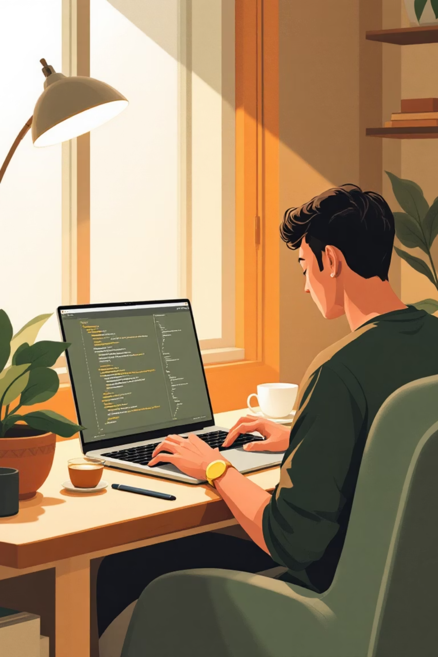

Next Hike IT Solution
Building My Second Project Advanced Calculator
A journey through Python, Tkinter, and personal growth

Slide 2
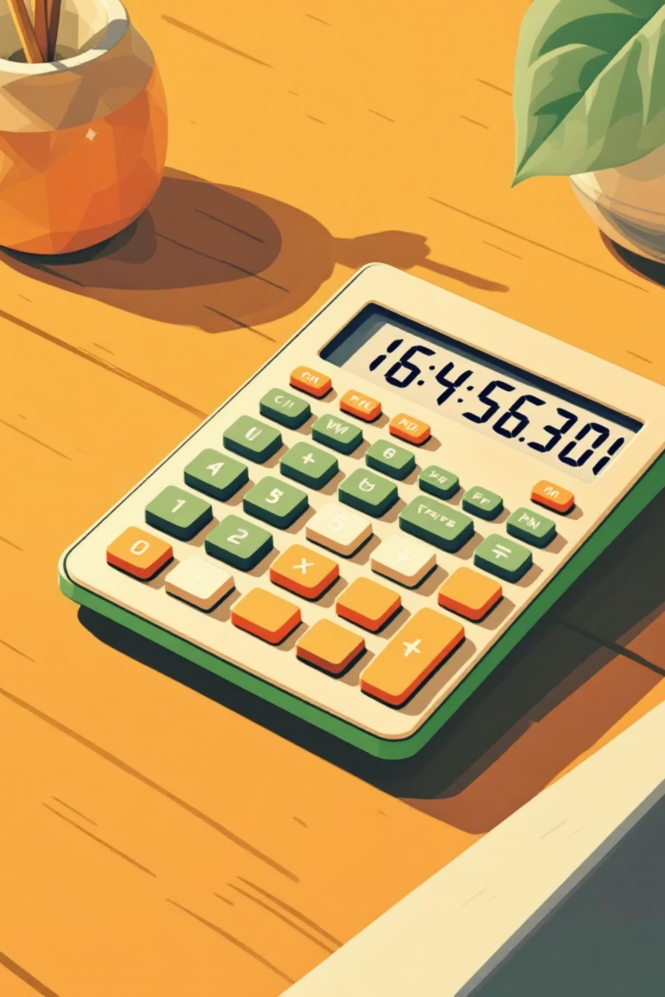
Why a Calculator?
The Challenge
The Goal
I wanted to build something functional and practical that would push my Python skills beyond basic scripts. A calculator seemed simple at first, but creating an advanced one with a polished GUI became my perfect learning project.
Move beyond console applications and create a real desktop application with buttons, displays, and professional functionality that people could actually use.

Slide 3

The Technology Stack
Python 3
Tkinter
Custom Logic
The core language powering all the calculation logic and program structure
Python's built-in GUI framework for creating the visual interface and user interactions
Hand-coded algorithms for advanced operations and error handling

Slide 4
The Development Journey
Week 1: Foundation
1
Learning Tkinter basics, creating simple windows and buttons. Everything felt new and challenging.
2
Week 2: Layout Struggles
Wrestling with grid layouts and widget positioning. Spent hours getting buttons to align properly.
Week 3: Core Logic
3
Implementing calculation functions, handling operator precedence, and managing the display state.
4
Week 4: Advanced Features
Adding scientific functions, memory operations, and keyboard support. The calculator came alive.
Week 5: Polish & Testing
5
Refining the UI, fixing edge cases, and adding error handling. The final push to completion.

Slide 5

The Biggest Struggles
Event Handling Chaos
Understanding how button clicks trigger functions and update the display took days. The callback system felt backwards at first, but eventually clicked.
Display State Management
Tracking what's on screen, what's in memory, and what operation is pending became a juggling act. One wrong variable and everything broke.
Error Edge Cases
Division by zero was just the beginning. Handling invalid inputs, operator sequences, and overflow scenarios required careful thinking.

Slide 6



The Breakthrough Moment
After two weeks of struggling with spaghetti code, I discovered the Model-View-Controller pattern. Suddenly, everything made sense.
Model
View
Controller
Calculation logic separate from UI
Tkinter interface that displays data
Event handlers connecting the two
This architectural shift transformed my messy prototype into a clean, maintainable application. The code became readable, debuggable, and extensible.

Slide 7

Key Features Implemented
Basic Operations
Addition, subtraction, multiplication, division with proper precedence
Scientific Functions
Square root, powers, trigonometry, logarithms for advanced calculations
Memory System
Store, recall, and clear functions just like professional calculators
Keyboard Support
Full keyboard input for faster operation and better user experience

Slide 8
What I Learned
GUI Programming Mindset
Software Architecture
Thinking in terms of events, states, and user interactions rather than sequential code execution. This shift in perspective opened up a whole new world of application development.
How to structure code for maintainability and scalability. Separating concerns and creating modular components made everything easier to manage.
Debugging Strategies
User Experience Thinking
Using print statements, breakpoints, and systematic testing to track down elusive bugs. Patience and methodical thinking became my best tools.
Designing intuitive interfaces and considering how people actually use software. Small details like button size and color make huge differences.

Slide 9
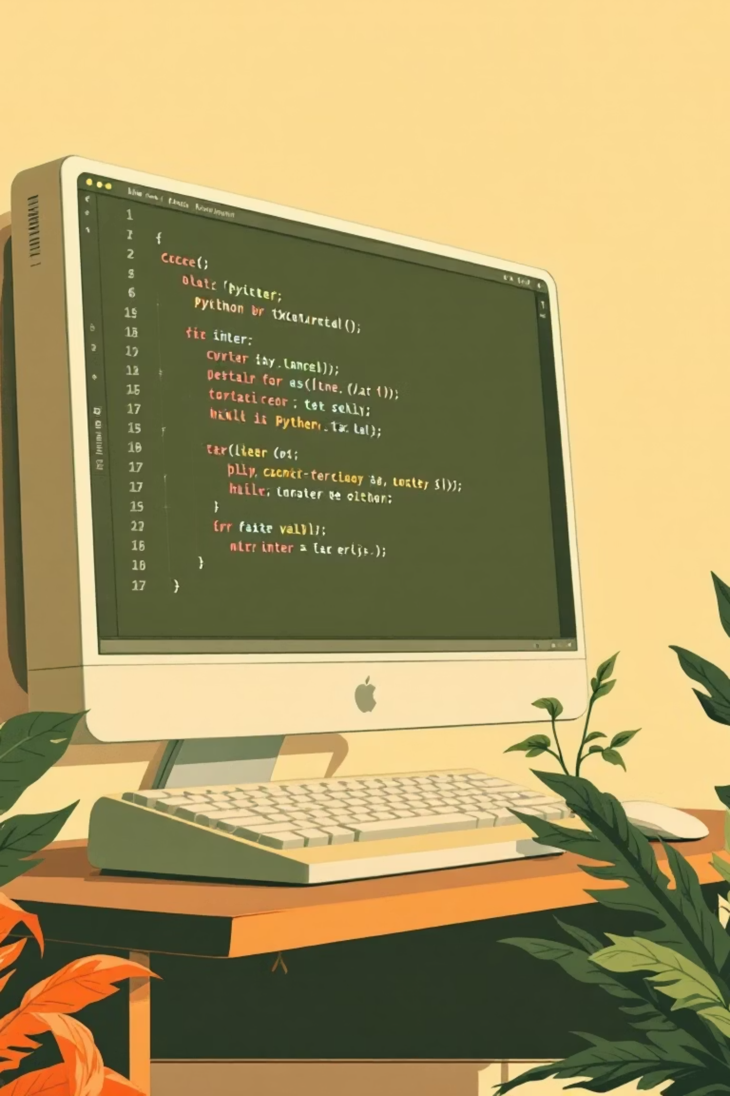
By the Numbers
450+
35
20+
Lines of Code
Hours Invested
Functions Created
From zero to a fully functional application
Late nights and weekend coding sessions
Modular, reusable calculation logic
100%
Growth Achieved
From beginner to confident GUI developer

Slide 10
What's Next?
This calculator project was just the beginning of my journey into application development. Here's where I'm headed:
Improve the UI
Add More Features
Explore themes, custom styling, and modern design patterns
Graphing capabilities, equation solver, and calculation history
New Projects
Package & Share
Apply these skills to build more complex applications
Create an executable and share it with the developer community
"Every expert was once a beginner who refused to give up. This calculator proves I can build anything I set my mind to."

